Slide 1
Sales BI
Building the Data Pipeline Project
Gitlab: https://gitlab2.bigdata220uw.mooo.com/auim/Team6_Assignment/tree/master
Team 6:
Maria Mendoza
Jayadev Vallath
Alexander Mendoza

Slide 2
Use Case – Low Latency
The use case is focused on reporting which paint sales territories have reached their gallon goal for the day which would qualify them for certain incentives and bonuses.
This scenario is critical, especially on the last day of the month and a real-time reporting of their progress is crucial to help their territory directors.
Metrics would be actual gallons sold vs plan
In this low-latency scenario, we will be using Postgres as the database to house all the necessary information and we will use Kafka as our messaging tool.

Slide 3
High Level Architecture
Entity B
Sales Representative
Sales Rep Id | Sales Rep Name | Sales Rep Territory | Daily Gallon Plan
1-001 | John Smith | NE | 500
1-002 | Linda Errico | SE | 1000
1-003 | Ed Snith | NYC | 3000
1-004 | Dennis Brunzell | GL | 2000
1-005 | Carl Kowaski | WC | 1000
1-006 | Jung Lim | NYC | 1000
1-007 | Andy Jerkin | NE | 500
1-008 | Carla Pollak | WC | 2000
1-009 | Samson Smith | TX | 4000
1-010 | Lori Ann Curt | SE | 3000
Territory
Territory ID | Territory Name
NE | North East
SE | South East
NYC | New York Metro
GL | Great Lakes
WC | West Coast
TX | Texas
Product
Product Id | Gallons
N001 | 5
A001 | 5
C005 | 0.5
M004 | 0.25
N005 | 0.5
Entity A
Transaction
Order Date | Order Time | Sales Rep Id | Product Id | Units Sold
May 31 2016 | 8:00 AM | 1-001 | N001 | 16
May 31 2016 | 8:00 AM | 1-001 | A001 | 10
May 31 2016 | 8:00 AM | 1-001 | M004 | 15
May 31 2016 | 8:00 AM | 1-001 | N005 | 18
May 31 2016 | 9:15 AM | 1-010 | C005 | 20

Slide 4
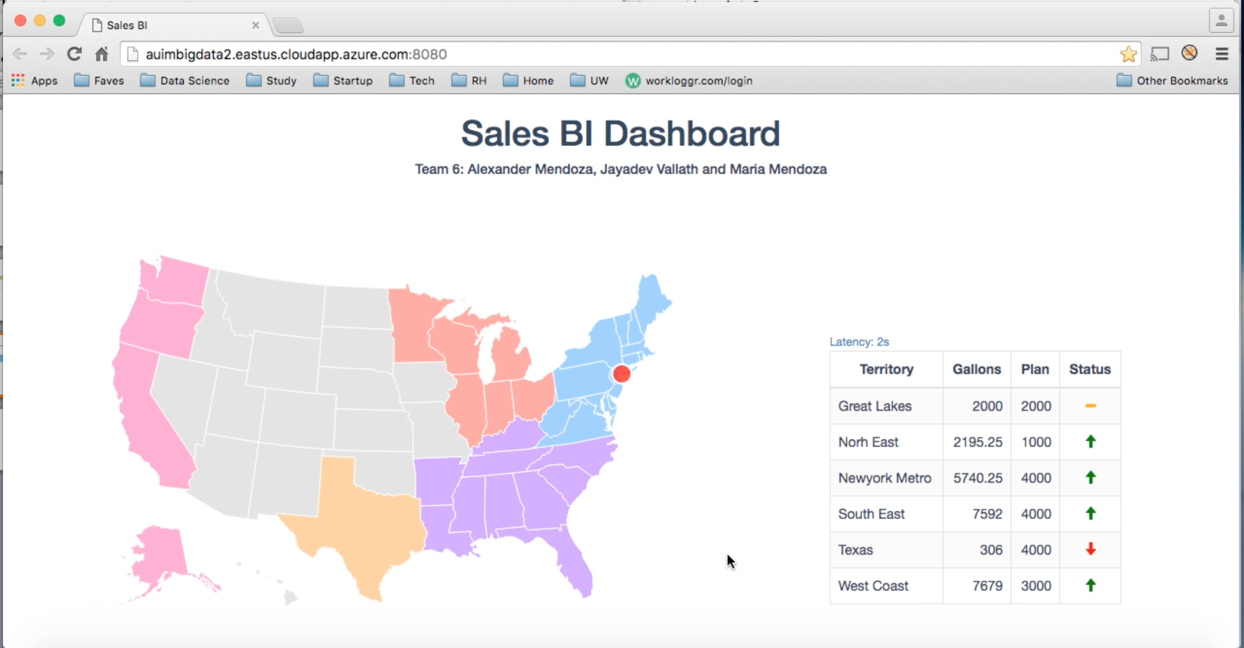
Results
Link: https://www.youtube.com/watch?v=Wblk_z_AffQ (actual video on next page)
As the messages arrive, the gallons column gets updated
The Status compares Gallons Sold vs Plan. Yellow means “Sold = Plan”. Red means “Sold less than plan” and Green means “Sold more than plan”
Latency in seconds:
Shows how long it took for the latest transaction to reach the dashboard.

Slide 5
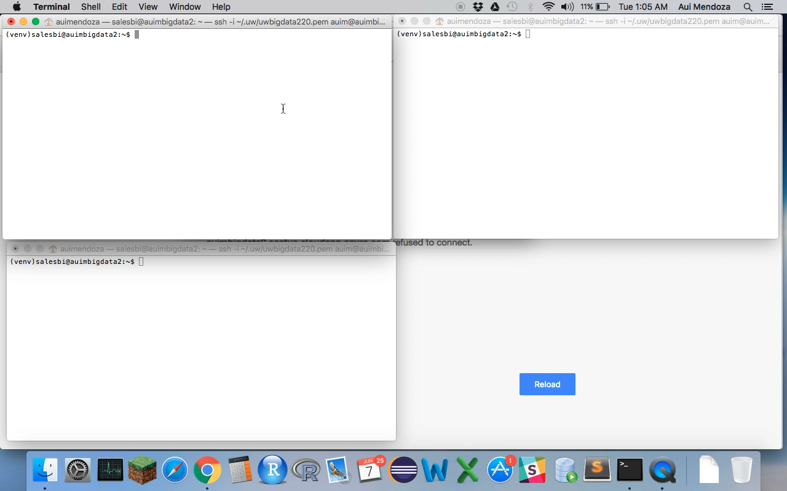
Actual Results Video

